Slide 1
Northern Ireland Residential Property
Price Index (NI RPPI)
Mr Alan Bronte
Dr David Marshall (NISRA)
Ms Ciara Cunningham
23 May 2012

Slide 2
Outline
Why LPS/ NISRA have created a NI RPPI
Data behind NI RPPI
Methods
Results for Quarter 1 2012

Slide 3
(a) Why have we created a NI RPPI
Rates based on discrete Capital Values
Capital Values based on detailed statistical modelling
NI RPPI will inform any future revaluation

Slide 4
(a) Why have we created a NI RPPI
Other indices based on sample of sales data
(e.g. estate agents, mortgages)
Access to full sales dataset
UK National Statistician Review

Slide 5
(b) Data behind NI RPPI
HMRC – Stamp Duty - by law sales reported
Transaction based (end of sales process)
January 2005 to date (150,000 NI data points)
Comprehensive “cleaned” dataset
        Ruled Out land sales, NIHE sales, outliers etc….
        Kept In auctions, cash sales, estate agents

Slide 6
(b) Data behind NI RPPI
135,000 verified property sales
linked to valuation list – type, size, neighbourhood etc…
Greater flexibility – detailed results
Distribution by price

Slide 7
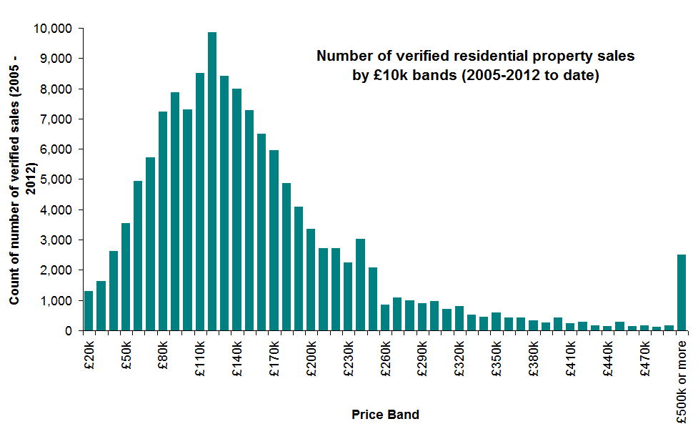
135,000 sales

Slide 8
(c) Methodology NI RPPI
Measure change in price over time
Quarterly Index
Challenges
properties sold infrequently
different properties sell over time (example)

Slide 9
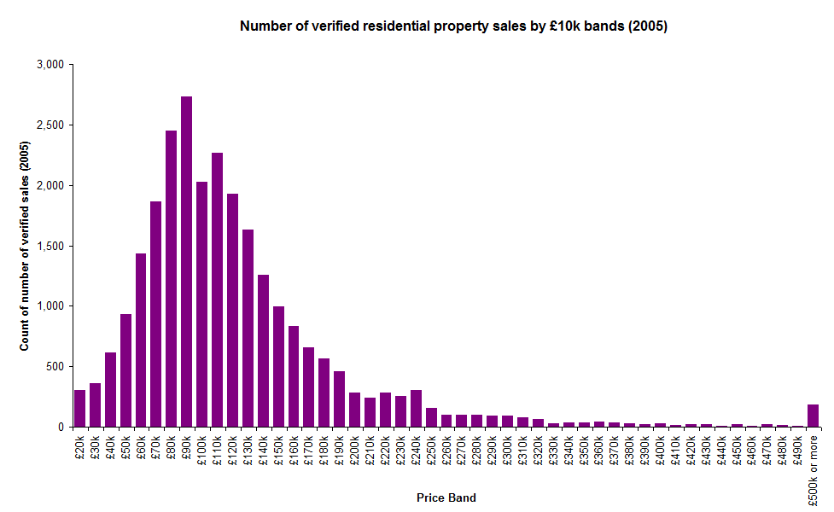
2005

Slide 10
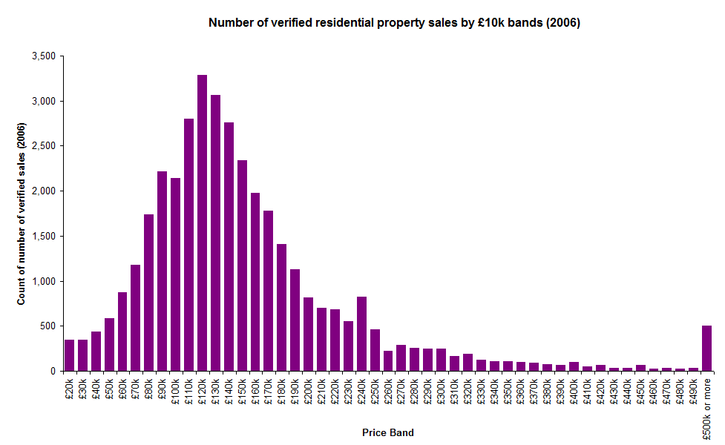

Slide 11
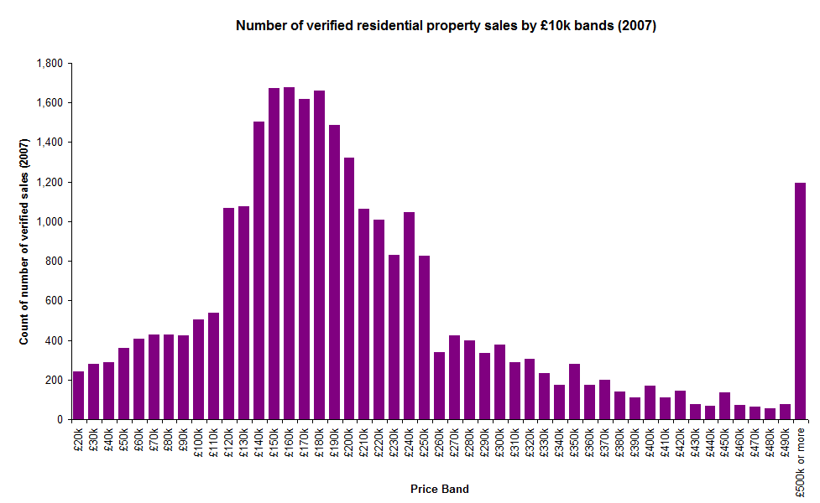
2007 – High Point

Slide 12
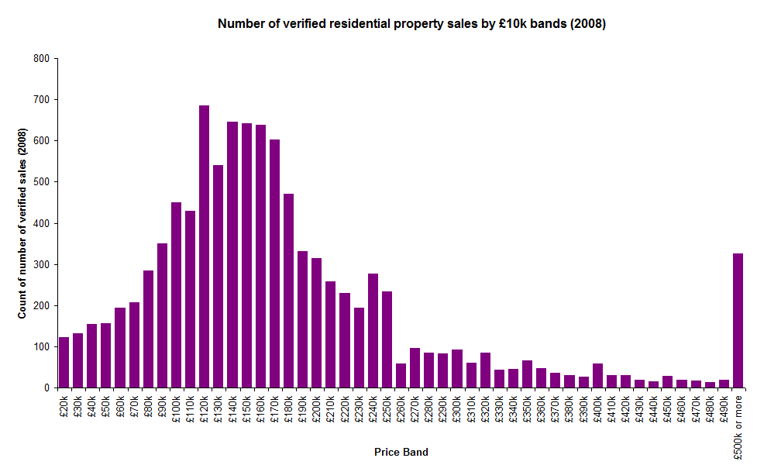

Slide 13
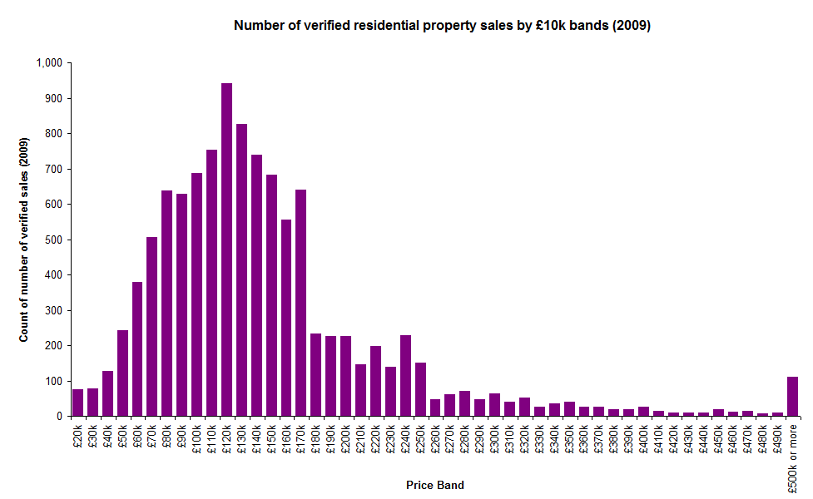

Slide 14
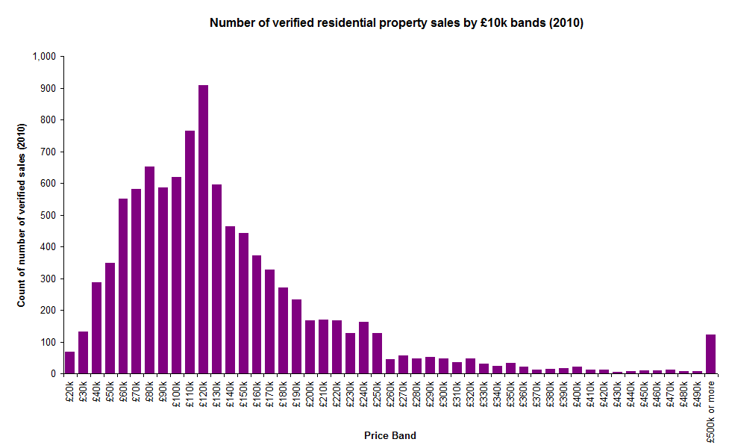

Slide 15
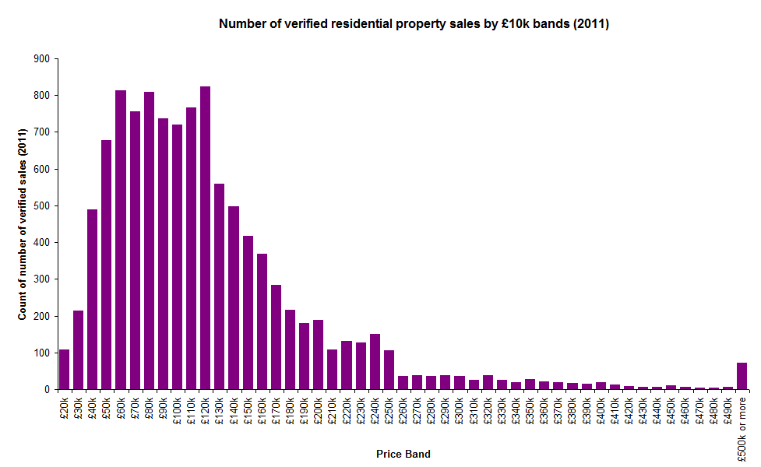

Slide 16
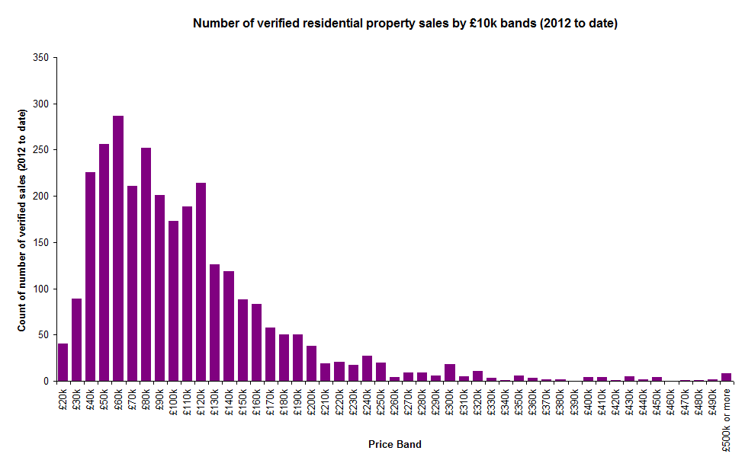
2012 to date

Slide 17
(c) Methodology NI RPPI
Link HMRC prices to key characteristics
  Size of property (square metres)
  Type of property (detached, semi, terrace, apartment)
  Neighbourhood of property
  Public / Private
Assess the impact of key characteristics on price
Apply this to a “standard property”
(e.g. 4% of terrace in Belfast, 0.5% of detached North Down)

Slide 18
(c) Methodology NI RPPI
This creates a “standardised price”
Convert to an RPPI
Baseline: 2005 Quarter 1 (January – March) = 100
e.g. if Quarter X = 103 (then prices 3% above baseline)
Report graphs Index from 2005 Q1 = 100 to 2012 Q1

Slide 19
(c) Price of a Typical Property
Not all properties sold, variation over time etc…
Simple Average: Influenced by large sales prices

Slide 20
135,000 sales

Slide 21
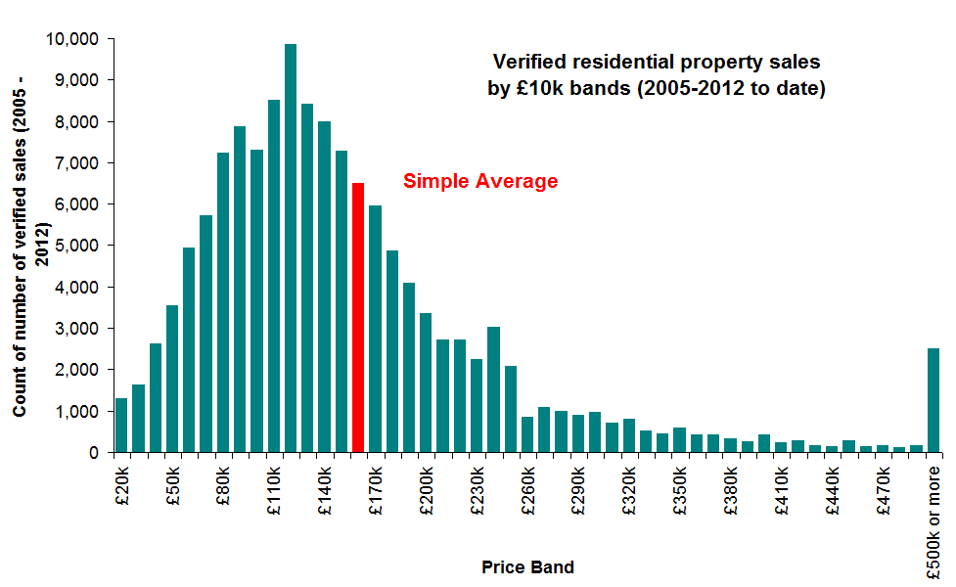

Slide 22
(c) Price of a Typical Property
Not all properties sold, variation over time etc…
Simple Average: Influenced by large sales prices
(b) Simple Median: Price above/below which 50% of properties are sold at

Slide 23
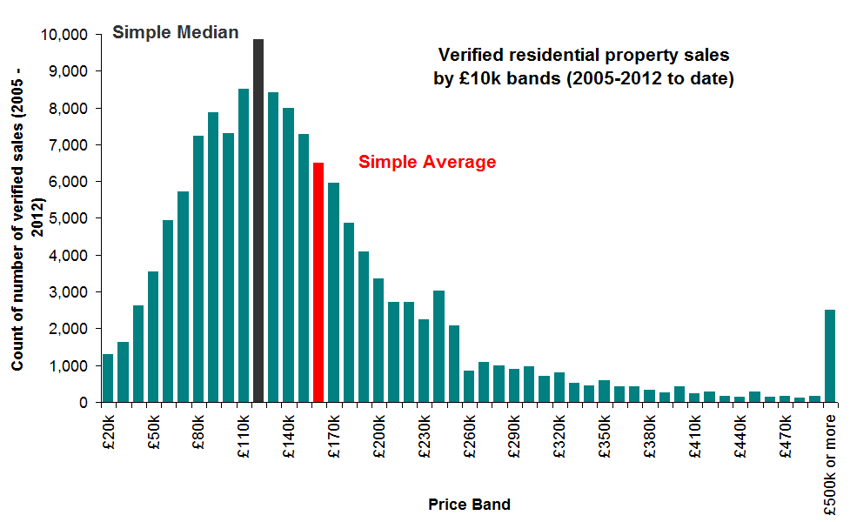

Slide 24
(c) Price of a Typical Property
Three figures presented in report
(a) Simple Average: Standard measure
(b) Simple Median: Price above/below which 50% of properties are sold at
(c) Standardised Price: Price of a “standard property”
Not comparable with other reports (different data)

Slide 25
Trend of NI RPPI 2005 to Quarter 1 2012

Slide 26

(d) Results Quarter 1 2012 - Summary
Quarter 1 2012: Index = 93
NI RPPI less than 50% of July-September 2007 peak
NI RPPI less than 2005 baseline
NI RPPI down 7% from Quarter 4 2011
NI RPPI down 13% from Quarter 1 2011
Notes:
Eg Interest rate trends, number of reposessions by area

Slide 27
Sales Volumes
Q1 2012:
  2,646 verified sales of residential properties
Q1 2011:
  2,436 verified sales of residential properties
  Increase of 9% over same quarter last year

Slide 28
(d) Price of a Typical Property
Three figures:
Simple Average: Standard measure
(b) Simple Median: Price above/below which 50% of properties are sold at
(c) Standardised Price: Price of a “standard property”

Slide 29
Type | Residential Property Sales Prices Summary Statistics (Quarter 1 2012)
 | Simple Average | Simple Median | Standardised Price
Detached
Semi-Detached
Terrace
Apartment
All | £112,160 | £98,000 | £98,487
Overall Standardised Price £98,487 (Q1 2012)
Simple Average £112,160 (Q1 2012)

Slide 30
Type | Residential Property Sales Prices Summary Statistics (Quarter 1 2012)
 | Simple Average | Simple Median | Standardised Price
Detached | £171,731 | £153,000 | £154,421
Semi-Detached | £108,370 | £110,000 | £101,686
Terrace | £68,577 | £62,000 | £63,808
Apartment | £90,146 | £79,500 | £80,433
All | £112,160 | £97,000 | £98,487
Range (Detached £154k - Terrace £64k)

Slide 31
(d) NI RPPI Q1 2012 – By Type
NI RPPI down 7% on quarter
Also all property types have fallen
  Terrace & Apartments down 12% on quarter
  Detached down 7% on quarter
  Semi-Detached down 4% on quarter
Detached properties at 2005 baseline
Terrace 20% less than 2005 baseline
Notes:
Eg Interest rate trends, number of reposessions by area

Slide 32
Price Index across types

Slide 33
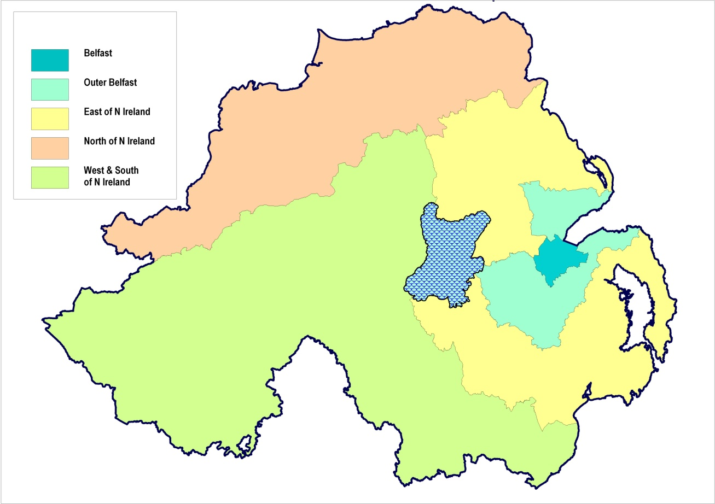
Regions within Northern Ireland

Slide 34
Regions within Northern Ireland
INDEX
Q1 2012
89
95
89
91
97

Slide 35
Regions within Northern Ireland
Percentage Change on Q4 2011
-7%
-8%
-8%
-4%
-8%

Slide 36
Price Index across Regions

Slide 37
Web addresses: http://www.dfpni.gov.uk/lps/index/about-lps/publications/statistics-and-research-publications.htm http://www.nisra.gov.uk/HousePriceIndex/hpi.html

